Slide 1

GLA UNIVERSITY MATHURA
SUBMITTED TO: SUBMITTED BY :
Mr. Manoj Varshney Manish kumar(191599010)
Pawan Tyagi(191599012)
Pawnesh Kumar Pundhir(191599013)

Slide 2

Project title
Music Player Application

Slide 3
INTRODUCTION
Music Player lets you manage all your music files quickly and easily .
This audio player supports almost all types of mp3 files and other audio formats .
Easily browse and play music songs by genres , albums , artists , songs and folder.

Slide 4
Language & Tools
Languages: Tools:
Flutter
Dart Language . Visual Code Studio

Slide 5
Technology Used
Flutter is Google’s mobile app SDK, complete with a framework, widgets, and tools, that gives developers an easy way to build and deploy visually attractive, fast mobile apps on both Android and iOS platforms.
Dart has a strong support base with many libraries and tools, which enable very large applications. ... Dart is very stable and it can be used to build production quality real-time applications..

Slide 6
System Features
Start Up
Android OS on the Smart Phone
The target device should be sound enabled
The android version should not be less than 2.3.5

Slide 7
Playlist Menu
Play
Stop
Pause
SongList
Next
Previous

Slide 8
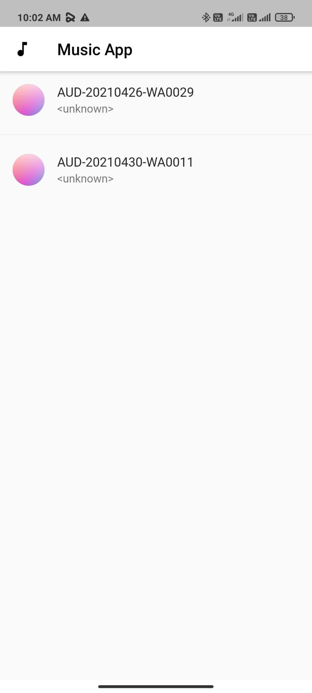
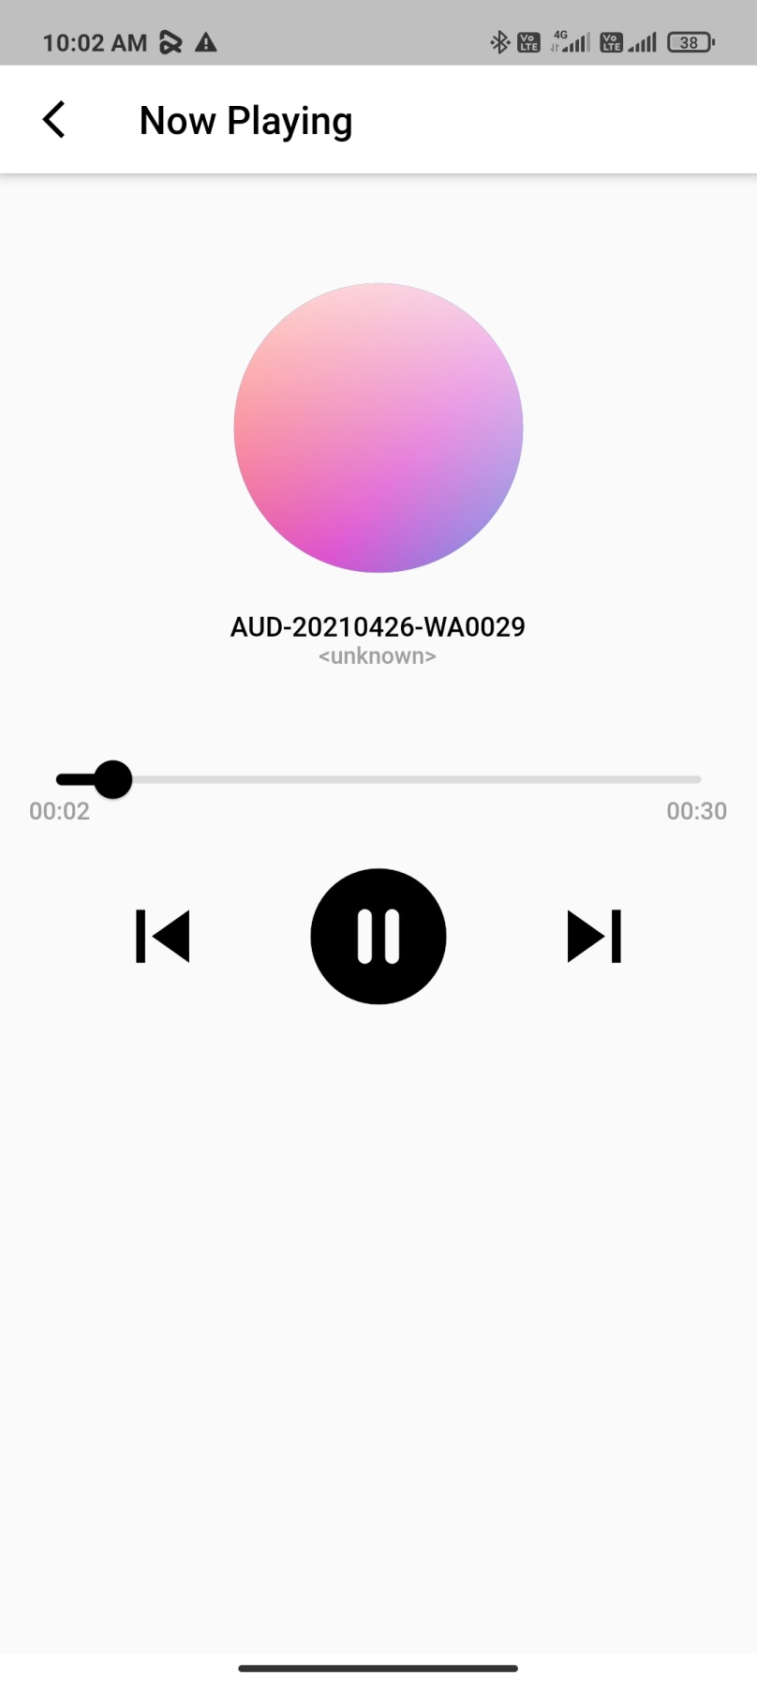
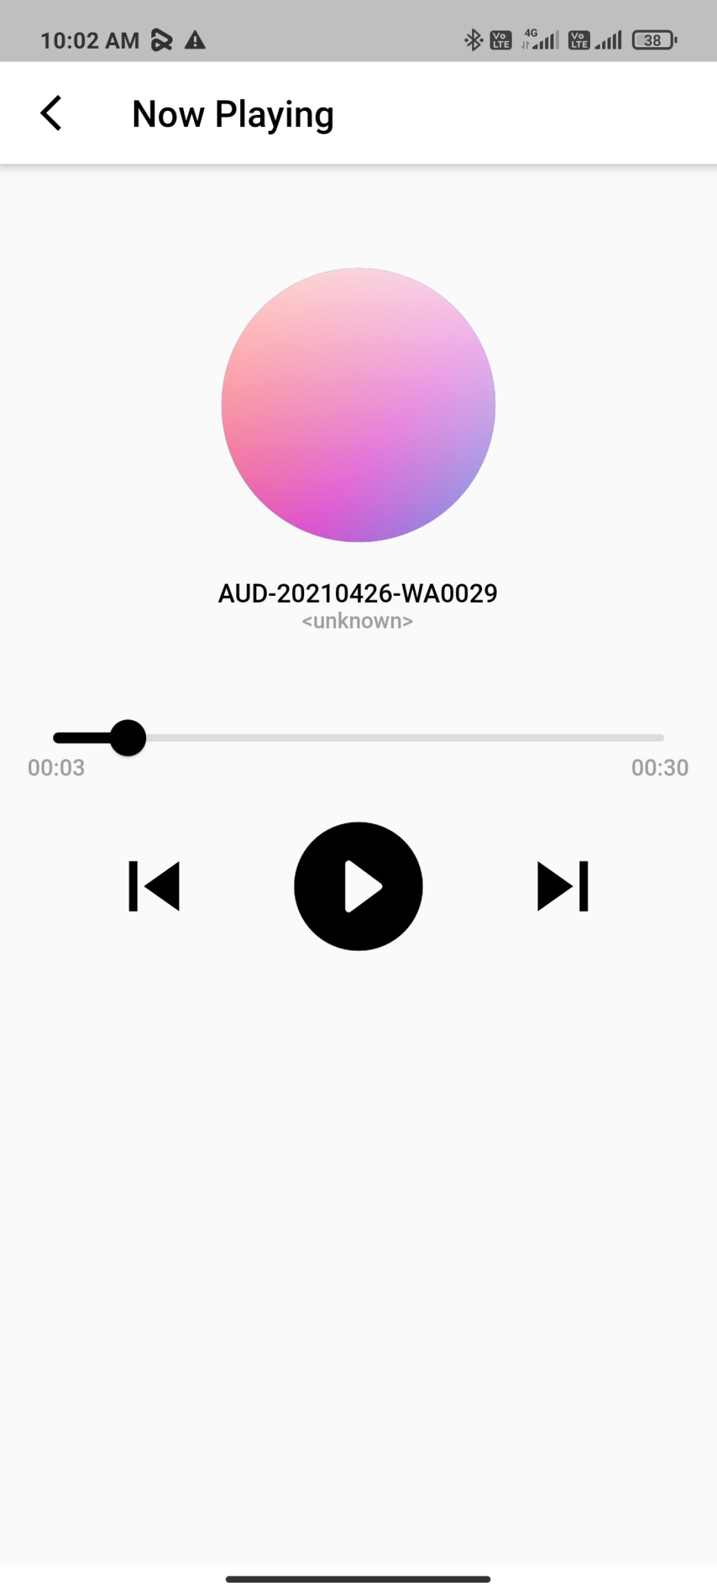
User Interface
Homepage
Stopped Song
Screen while Playing Song

Slide 9
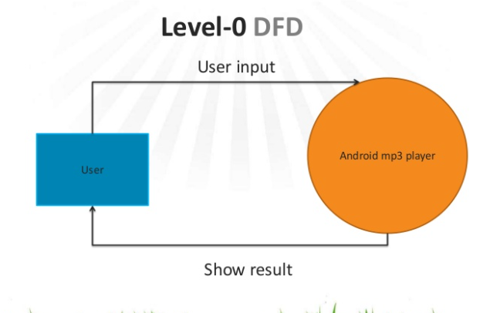
Level -O DFD

Slide 10
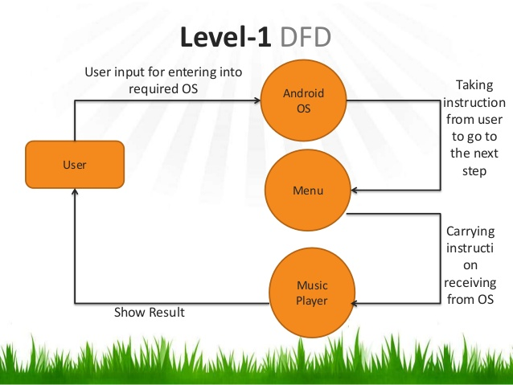
Level - 1 DFD

Slide 11
Advantage
Large Amount of Data Storage. An MP3 player offers much more storage space than a CD. ...
Easier to Transport. MP3 players are much more compact than CD players. ...
Durability. ...
Easier File Transfer. ...
Easier to Use.

Slide 12
Some Important Goals
We can implement some advanced features like Machine Learning Algorithms to make the app smart and recommend users the songs of their liking.
Improve UI of the app to make it look more pleasing and attractive to users.
Enhance the User experience of the app to ease the way of interactive with the app.
.

Slide 13
Thank
you

